Slide 1
The Ley of the Land
Sifting Through the Myths
By Lauren McIntire
ENG 102 (Stiles – RCC)

Slide 2
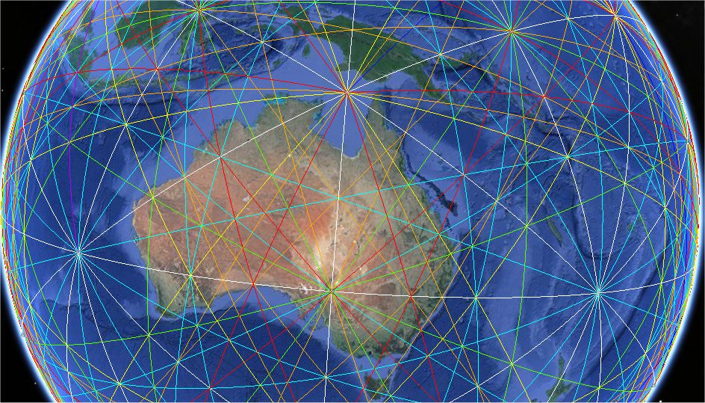
Notes:
What do you see when you look at this image of earth? It kind of looks like one of those “string art” pieces you find on Etsy. But all of those straight lines crisscrossing the globe are called ley lines.

Slide 3
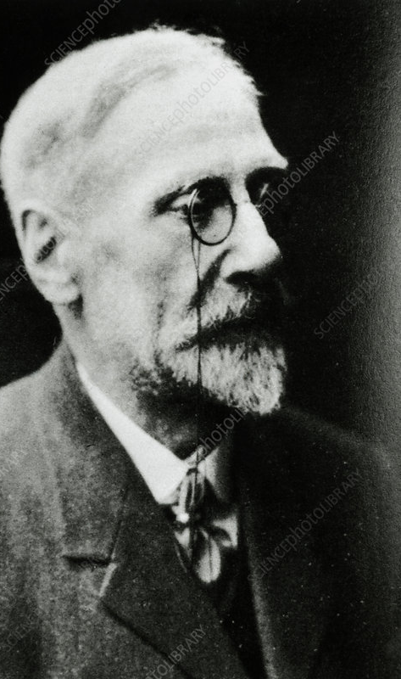
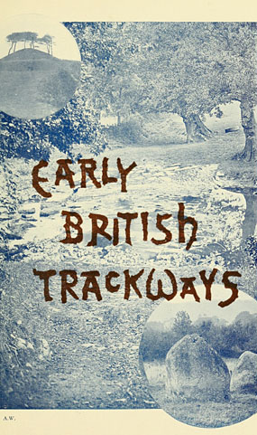
Alfred Watkins
Notes:
Ley lines first came to be known in the early 20th century by an amateur archaeologist and photographer by the name of Alfred Watkins, who gave a lecture titled “Early British Trackways” to the Woolhope Naturalists’ Field Club of Hereford. He theorized that “straight lines could be drawn between various historic structures and that these represented trade routes created by ancient British societies”.

Slide 4
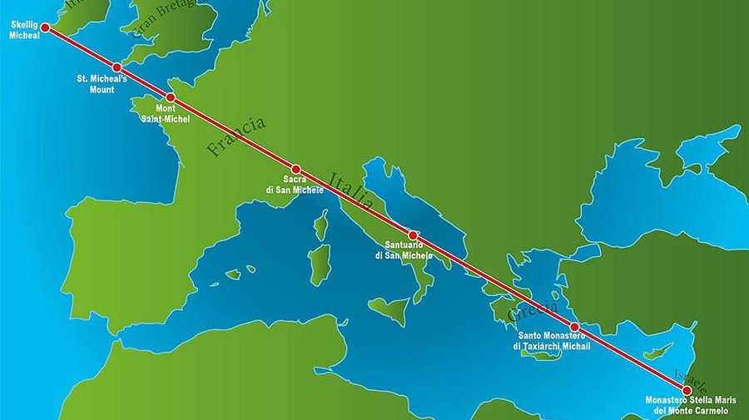
Michael Ley Line (Ireland to Israel)
Notes:
This image shows one of the Michael ley lines, that stretches from Ireland to Israel, where seven monuments exist (whether in the form of a well, a church, or a natural earthwork) that are all connected to St. Michael.

Slide 5
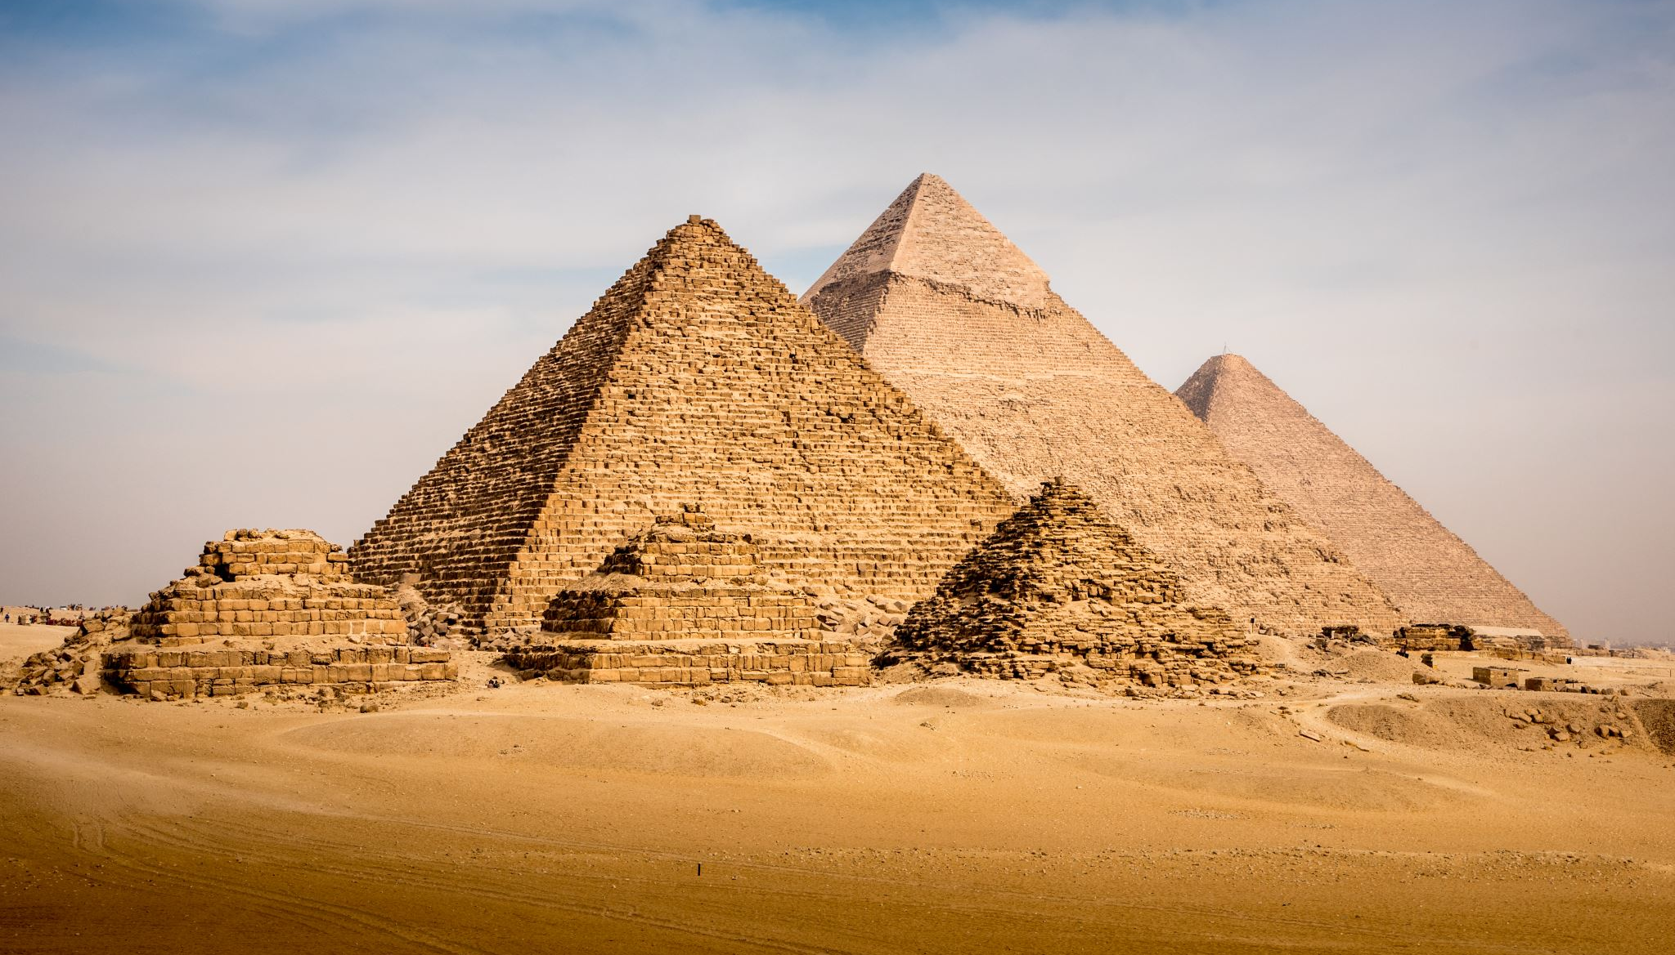
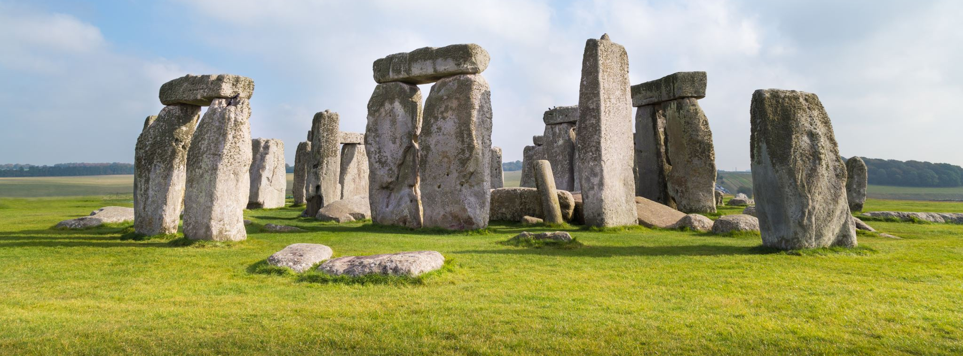
Pyramids of Giza, Al Haram, Egypt
Le Mont-Saint-Michel, Normany, France
Stonehenge, Wiltshire, England
Notes:
Le Mont-Saint-Michel in Normandy, France; the Pyramids of Giza in Al Haram, Egypt; and Stonehenge, Wiltshire, England are all along ley lines connecting them to other places of cultural, spiritual and/or historical significance.

Slide 6
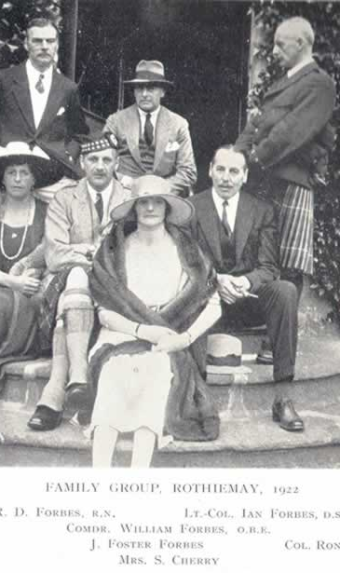
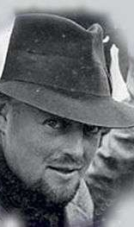
T. C. Lethbridge
Notes:
Besides Alfred Watkins, John Foster-Forbes, T.C. Lethbridge, and Guy Underwood were instrumental in the establishment of ley lines. So much so that they put their careers, and reputations, on the line.

Slide 7
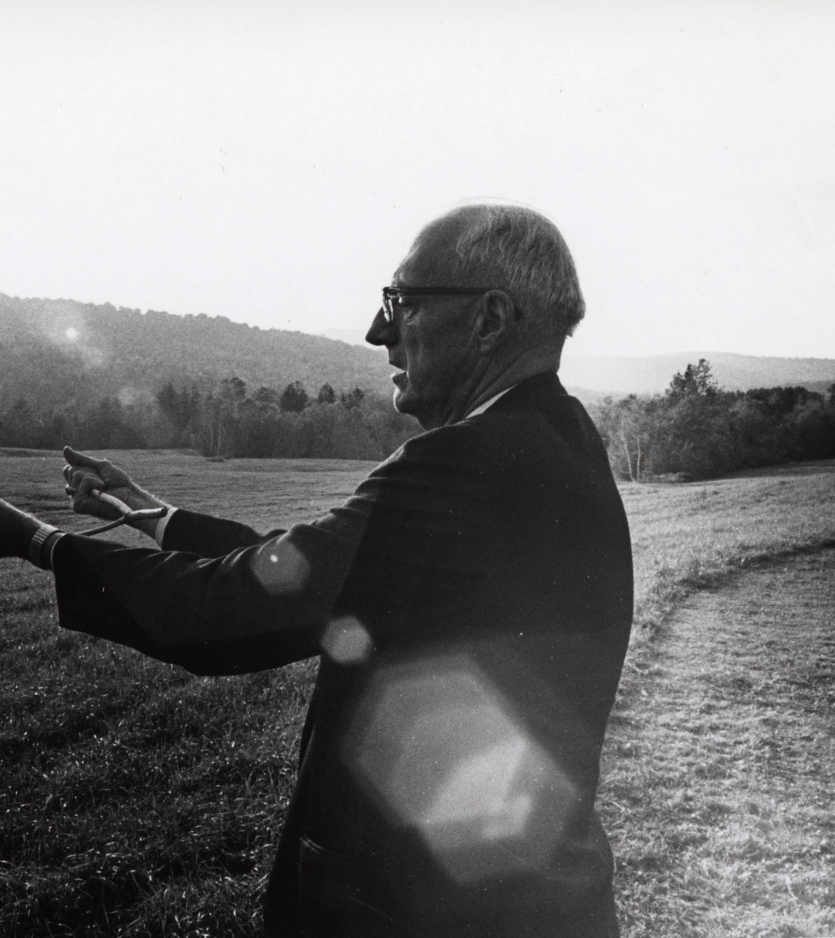
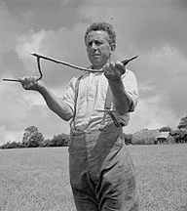
Divining or “Dowsing”
Notes:
Divining, or “dowsing”, is a technique for searching for underground water, minerals, and energies in the natural environment using a pointer or a pendulum that responds to unseen influences. The more devoted followers of ley theory use these practices to follow ley lines.

Slide 8
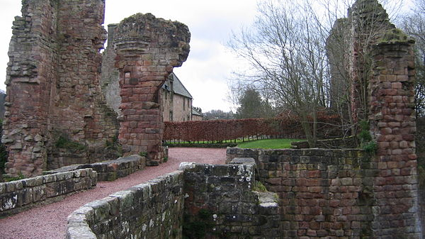
Sight Points (such as Rosslyn Castle Ruins)
Notes:
Watkins had provided step-by-step instructions of ley hunting that was based upon a system of recognizing what he called “sight points” and the “mark points” that lay in-between. He described sight points as “points of archaeological significance that correspond to a linear formation”, for example, the Rosslyn Castle ruins.

Slide 9
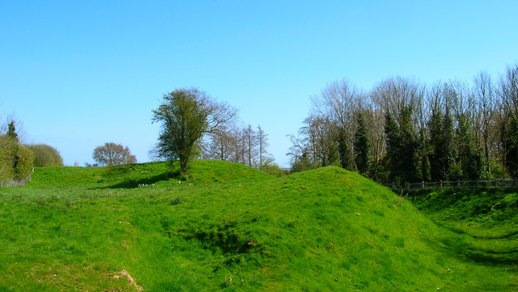
Mark Points (such as this mound near Rosslyn Castle)
Notes:
Watkins described mark points as “including mounds, moats, mark-stones, and beacons” such as this mound near the Rosslyn Castle ruins.

Slide 10
Confirmation Points (such as Rosslyn Chapel)
Notes:
Watkins then asked the ley hunters to “look for further evidence of a ley line in the form of “confirmation points” (churches, crosses, fords, tree rings, etc.) such as the Rosslyn Chapel.

Slide 11
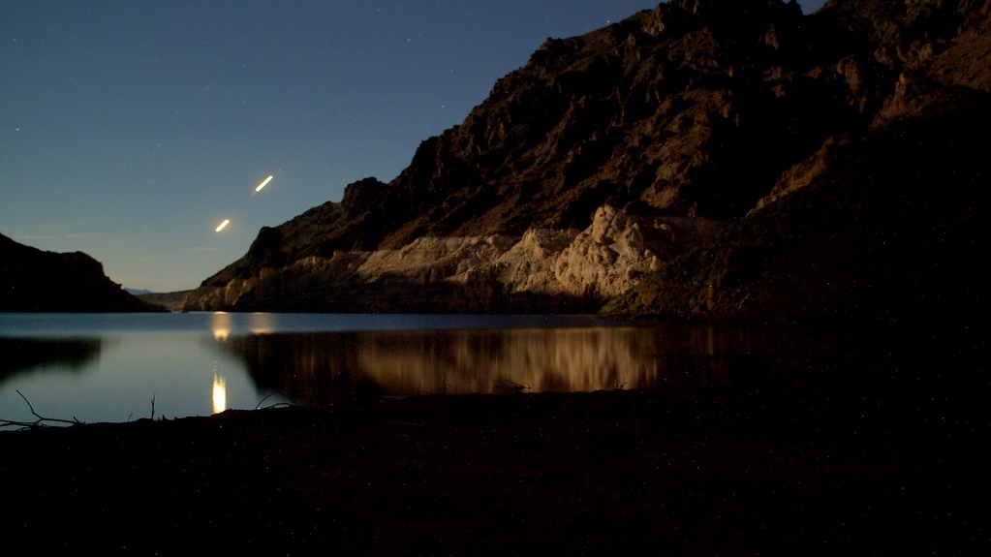
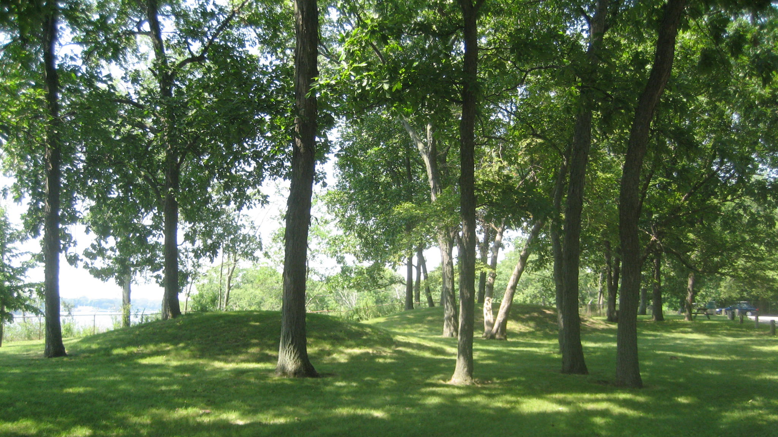
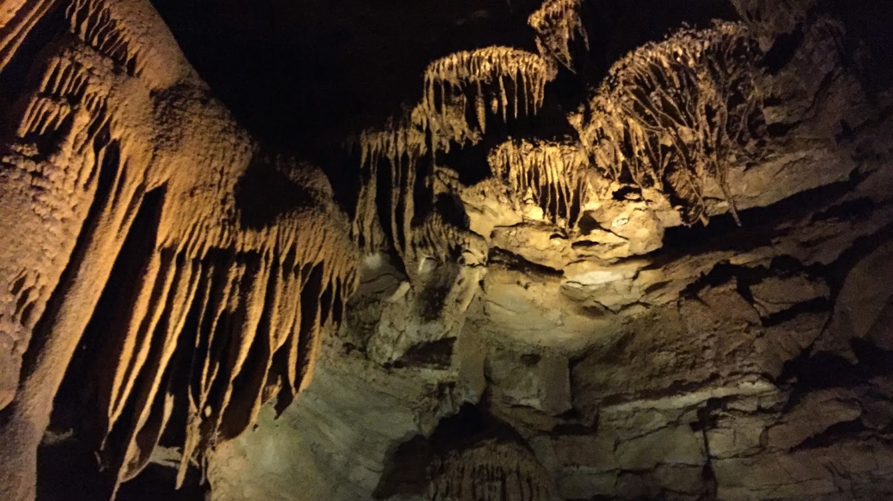
Manitoba, Canada
Sinnissippi Mounds, Sterling, Illinois
Elk River, Minnesota
Mammoth Cave, Kentucky
Notes:
There is a ley line that crosses through Illinois that has a few points of interest on it. Manitoba, Canada (near Prawda) is well-known for being where the most UFO sighting have been recorded (2,000+ in 200 years). For the record, I mean UFOs in the literal sense, not in the little green men in spaceships sense. There is also Sinnissippi Mounds in Sterling, Illinois which is a Hopewell culture burial mound estimated to be about 2,000 years old. Elk River, Minnesota has been the site of many interesting weather patterns in the form of “showers of reptiles”. And Mammoth Cave, Kentucky which is the world’s largest cave system at 405 miles.

Slide 12
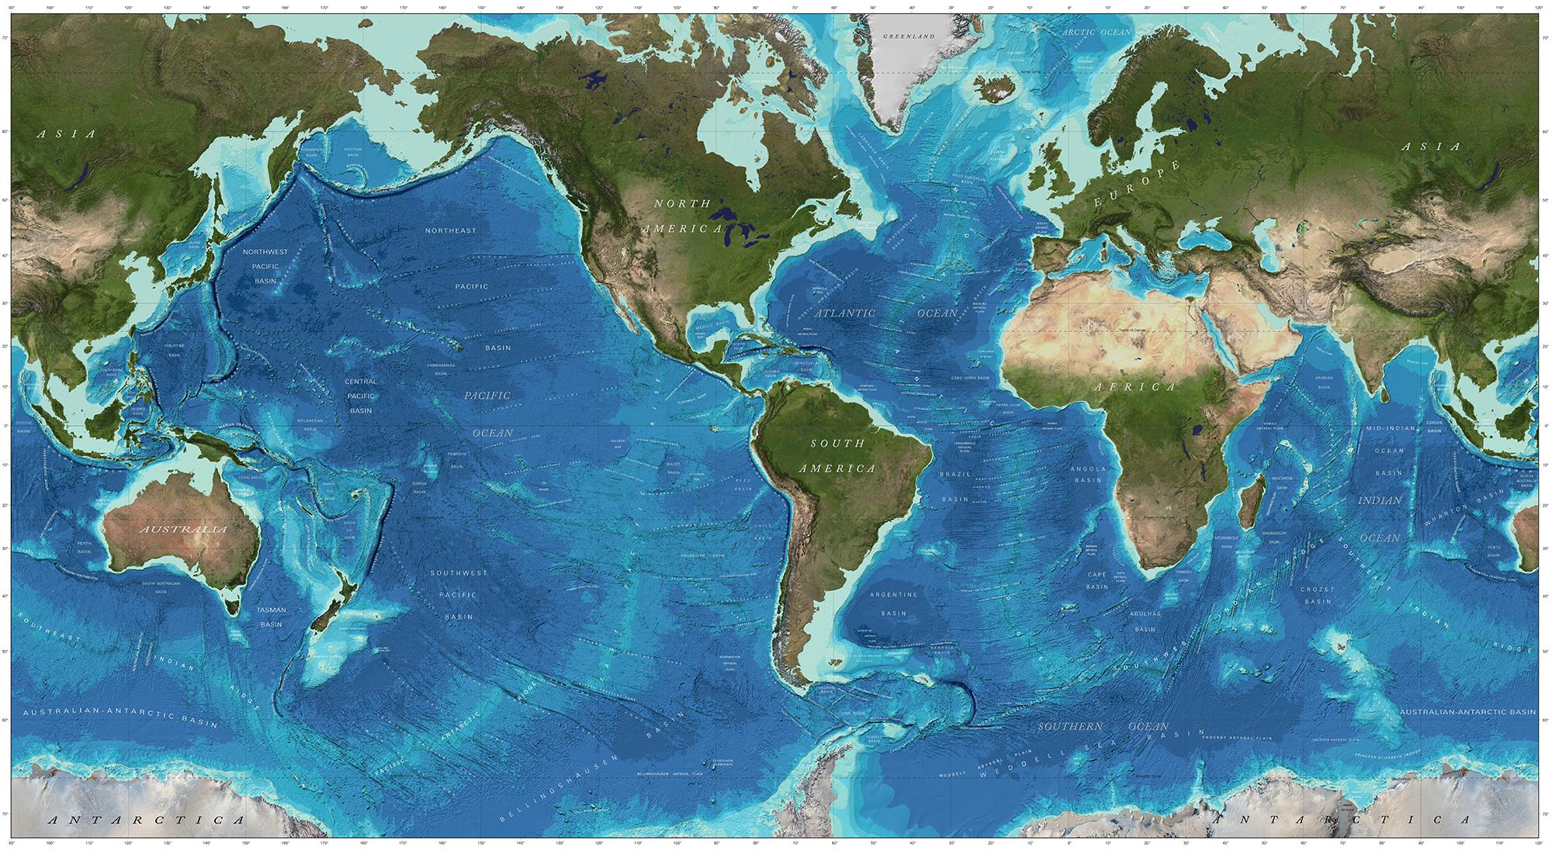
Deep Map of Our World
Notes:
Walking a ley line allows for freedom of movement, strengthening one’s connection to the environment, like an expedition of sorts. It creates a deep map of our world, a map that has patterns that center around that idea.

Slide 13
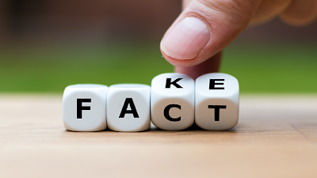
Notes:
Whether ley lines actually exist, or whether there is any legitimate reason to believe in them is of little importance when what we are doing is questioning the soundness of our own understanding of the world we live in by moving between sites of historical importance using what was once considered an innovative system.

